Slide 1


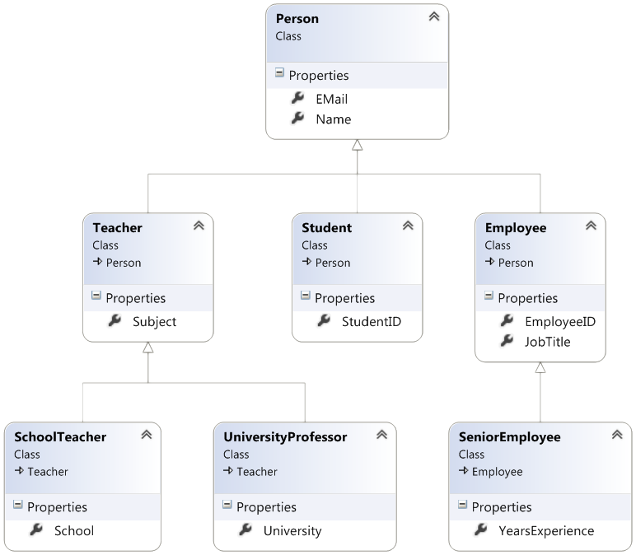

Inheritance
Class Hierarchies
Java OOP
Basics
SoftUni Team
Technical Trainers
Software University
http://softuni.bg

Slide 2
Table of Contents
Fundamental Principles of OOP
Inheritance
Class Hierarchies
Inheritance and Access Levels

Slide 3
Questions
sli.do #3666

Slide 4
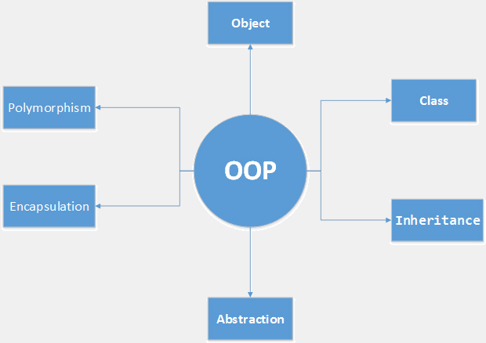
Fundamental Principles of OOP
Notes:
(c) 2006 National Academy for Software Development - http://academy.devbg.org*
4##

Slide 5
Fundamental Principles of OOP
Encapsulation
Inheritance
Inherit members from parent class
Inherit constructors from parent class
Polymorphism
Abstraction

Slide 6
Inheritance
Notes:
(c) 2006 National Academy for Software Development - http://academy.devbg.org*
6##

Slide 7
Types of Inheritance
base class /
parent class
derived class
inherits
Notes:
Base (parent) class
The class giving its members to its child class
Derived (child) class
The class taking members from its base class

Slide 8
Types of Inheritance (2)
class
implements
interface
Notes:
A Class, could implement many interfaces, but could extend only single class !

Slide 9
Types of Inheritance (3)
derived interface
extends
base interface
Notes:
Interfaces could also be inherited and extended

Slide 10
Inheritance – Benefits
Extensibility
Reusability
Provides abstraction
Notes:
Extensibility / Polymorphism: New functionality may be easily plugged in without changing existing classes as long the new plug-in classes extend given base classes.
Reusability: For a set of similar applications a framework can be defined using a core set of classes that are to be extended by classes that fill in the application-dependent part.
Information Hiding: If a more general class using a simpler contract is sufficient, details from extending classes may be hidden to some of the client classes. This allows them to be more independent from possible changes and diminishes the load of contracts that must be understood by a reader of these client classes.
(c) 2006 National Academy for Software Development - http://academy.devbg.org*
10##

Slide 11

Examples - Incorrect
Don't use it to build has-a relationship
E.g. dog has-a name (dog is not a name)
Notes:
Do not use the Inheritance for building a “has – a” relationships between an objects. It is a rough design mistake !
(c) 2006 National Academy for Software Development - http://academy.devbg.org*
11##

Slide 12

Examples - Correct
Use inheritance for building is-a relationship
E.g. dog is-a animal (dog is an animal)
Notes:
The right way of creating an object relationships is to use “is – a”.
When you have a situation to decide, do you need inheritance or composition, ask your self, does the object “is – a” or it “has – a”.
(c) 2006 National Academy for Software Development - http://academy.devbg.org*
12##

Slide 13
How to Define Inheritance?
class DerivedClass extends BaseClass

Slide 14
How to Define Inheritance? (2)
Use super to invoke the parent constructor
public Circle(int x, int y) { super(x, y); }

Slide 15

Exercises in Class

Slide 16
Inaccessible Members
Private members are
hidden

Slide 17
Inheritance – Example
Base class
Person
+Name: string
+Address: string
Derived class
Derived class
Employee
Student
+Company: string
+Salary: decimal
+School: string

Slide 18
Class Hierarchies
Game
SinglePlayerGame
MultiplePlayersGame
Minesweeper
Solitaire
BoardGame
Chess
Backgammon

Slide 19
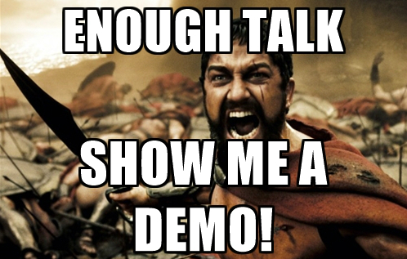
Simple Inheritance
Live Demo

Slide 20
Access Modifiers in Java
public
private
protected
no modifier
Notes:
public – access is not restricted
private – access is restricted to the containing type
protected – access is limited to the containing type and all types derived from it
no modifier – access is limited to the current package

Slide 21
Inheritance: Important Aspects
There is no multiple
inheritance
Notes:
We are not allowed to inheriting more than one class, but we are allowed to implement multiple interfaces !
That should help you to design your application.

Slide 22
Inheritance: Important Aspects (2)
Constructors are
not inherited
Notes:
Constructors are not inherited. Inheritance is used to reduce the code and especially to reuse it. So the subclass is creating its own constructor, which is calling
the constructor of the Parent class. So it is right design decision to be forbidden, inheritance of constructors.

Slide 23
Inheritance: Features
Extended class could add new members,
but couldn’t remove derived members
Notes:
You should always, only add ne functionalities, but never reduce or change them! Good practice is to add new methods if it is needed and never change the behaviour of already defined ones.

Slide 24
Inheritance: Features (2)
New members with the same name
or signature
hide the inherited ones

Slide 25
Exercises in Class

Slide 26
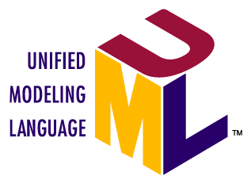
Inheritance Hierarchies
UML class diagrams
Notes:
Classes are represented by rectangles
Relations between classes are shown as arrows
Closed triangle arrow means inheritance
Other arrows mean some kind of associations

Slide 27
UML Class Diagram – Example
interface
Shape
struct
ISurfaceCalculatable
Point
#Position:Point
+CalculateSurface:float
+X:int
+Y:int
+Point
Square
Rectangle
struct
Color
-Size:float
-Width:float
-Height:float
+RedValue:byte
+Square
+GreenValue:byte
+CalculateSurface:float
+Rectangle
+BlueValue:byte
+CalculateSurface:float
+Color
FilledSquare
FilledRectangle
-Color:Color
-Color:Color
+FilledSquare
+FilledRectangle

Slide 28
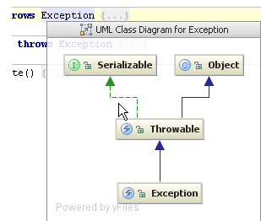
Class Diagrams in IntelliJ Idea
Live Demo

Slide 29

Summary
Inheritance allows extending the behavior of the classes
Inheriting Fields
Inheriting Methods
Reusing the existing code

Slide 30








OOP – Encapsulation
https://softuni.bg/java-basics-oop

Slide 31

License
This course (slides, examples, demos, videos, homework, etc.) is licensed under the "Creative Commons Attribution-NonCommercial-ShareAlike 4.0 International" license
Attribution: this work may contain portions from
"Fundamentals of Computer Programming with Java" book by Svetlin Nakov & Co. under CC-BY-SA license
"OOP" course by Telerik Academy under CC-BY-NC-SA license

Slide 32






Free Trainings @ Software University
Software University Foundation – softuni.org
Software University – High-Quality Education, Profession and Job for Software Developers
softuni.bg
Software University @ Facebook
facebook.com/SoftwareUniversity
Software University @ YouTube
youtube.com/SoftwareUniversity
Software University Forums – forum.softuni.bg

